Slide 1
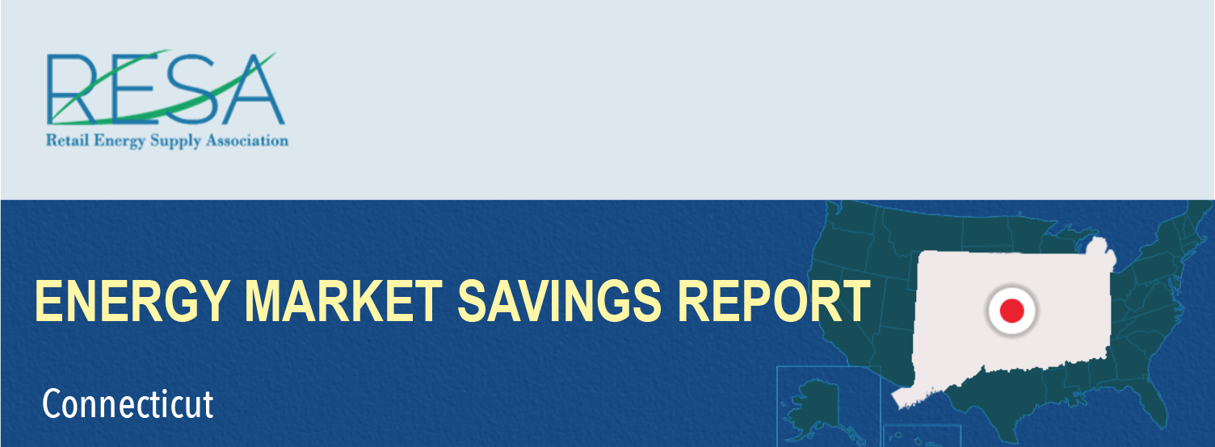
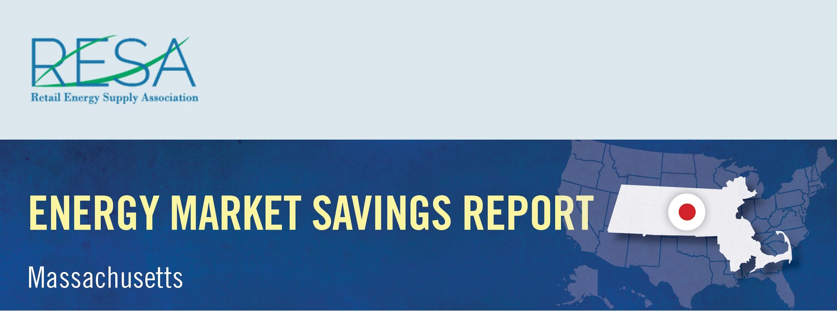
By shopping for the best deal for electricity, Connecticut consumers could have saved more than $12.8 million in February and benefited from a wide range of value-added products and services by switching to competitive suppliers.
Savings Over
Eversource – CL&P: | $11,919,791
United Illuminating: | $908,286
February Potential Market Savings: | $12,828,077
February Notable Offers:
Monthly shopping/dining certificate
Electric vehicle charger rebate and free weekend EV charging
Charitable donation based on customer usage
Source: Connecticut Rate Board – www.energizect.com

