Slide 1
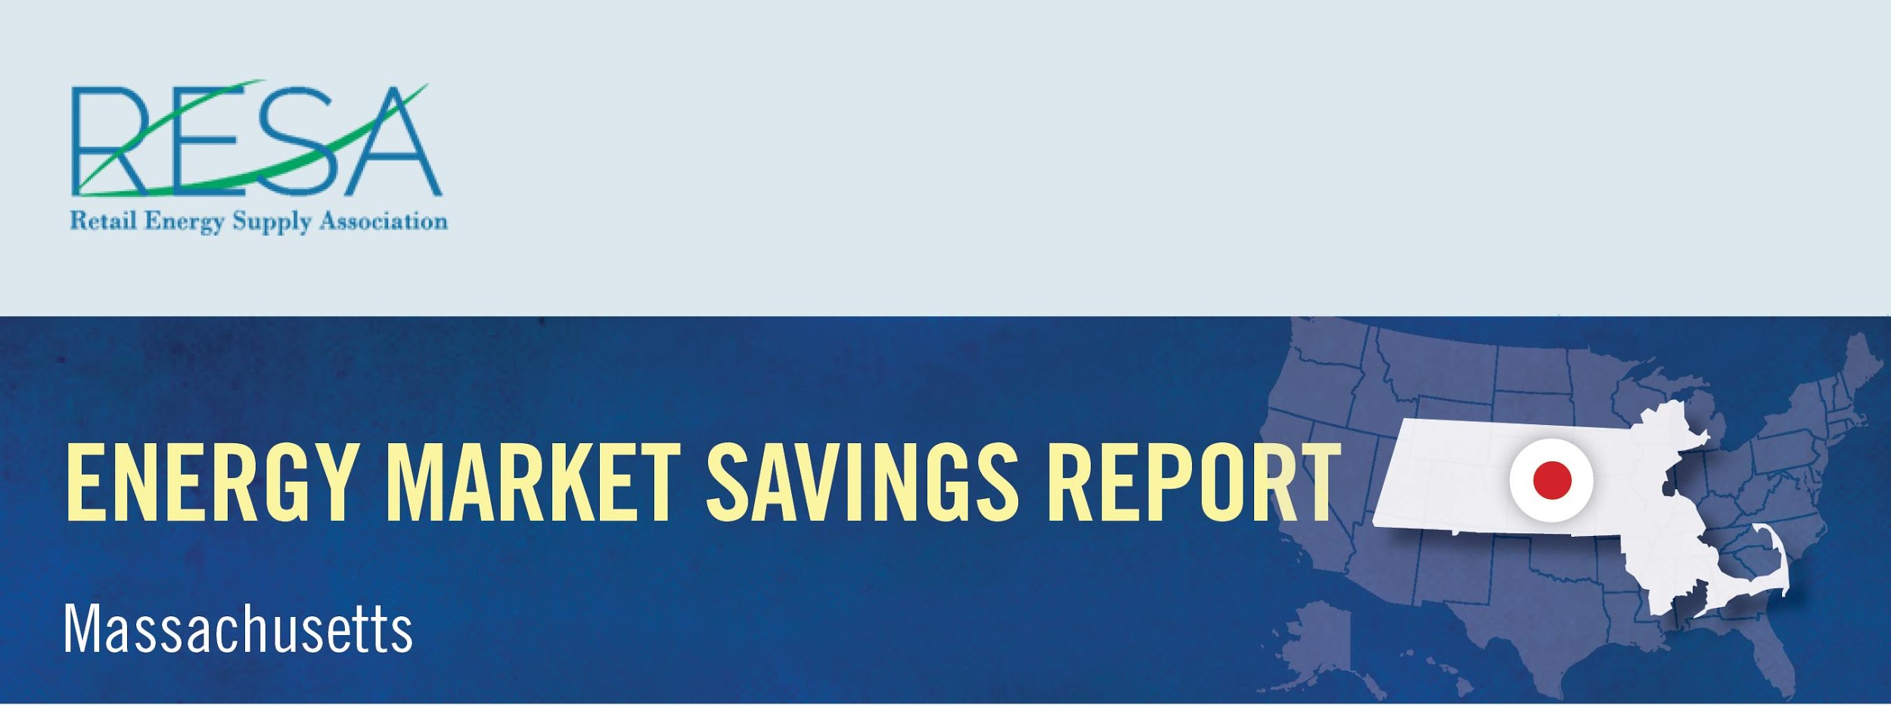
By shopping for the best deal for electricity, Connecticut consumers could have saved more than $13.8 million in March and benefited from a wide range of value-added products and services by switching to competitive suppliers.
Savings Over
Eversource – CL&P: | $12,435,474
United Illuminating: | $1,413,518
March Potential Market Savings: | $13,848,992
March Notable Offers:
Monthly shopping/dining certificate
Electric vehicle charger rebate and free weekend EV charging
Charitable donation based on customer usage
Source: Connecticut Rate Board – www.energizect.com

