Slide 1
Pennsylvania All-Sector Choice States Have Better Price Performance Than Monopoly States
From 1998 to 2019, competitive jurisdictions outperformed monopoly states from a price change perspective across All-Sectors. This is also true in Pennsylvania, which experienced a price increase of 25.3% over this time period. Meanwhile, the monopoly states experienced a weighted-average price increase of 67.0% over the identical time period for this same customer group.
Original Source: The Great Divergence in Competitive and Monopoly Electricity Price Trends- O’Connor/Khan
Notes:
This chart shows the state-by-state ranking for percentage changes in average electricity prices for customers in All-Sectors. Choice states outperform in the lower end of the spectrum, indicating choice states generally have done better than monopoly states from a price change perspective over this time period.
This is also true in Pennsylvania, which experienced a price increase of 25.3% over this time period. Meanwhile, the monopoly states experienced a weighted-average price increase of 67.0% over the identical time period for this same customer group.
The divergence in trends can be explained by choice states’ ability to better deal with the ‘converging conditions’, namely:
Increase in renewables
Flat load
Shale gas revolution

Slide 2
Pennsylvania Residential Sector Choice States Have Better Price Performance Than Monopoly States
From 1998 to 2019, competitive jurisdictions outperformed monopoly states from a price change perspective in the Residential Sector. This is also true in Pennsylvania, which experienced a price increase of 39.7% over this time period. Meanwhile, the monopoly states experienced a weighted-average price increase of 64.2% over the identical time period for this same customer group.
Original Source: The Great Divergence in Competitive and Monopoly Electricity Price Trends- O’Connor/Khan
Notes:
This chart shows the state-by-state ranking for percentage changes in average electricity prices for customers for the Residential Sector. Choice states outperform in the lower end of the spectrum, indicating choice states generally have done better than monopoly states from a price change perspective over this time period.
This is also true in Pennsylvania, which experienced a price increase of 39.7% over this time period. Meanwhile, the monopoly states experienced a weighted-average price increase of 64.2% over the identical time period for this same customer group.
The divergence in trends can be explained by choice states’ ability to better deal with the ‘converging conditions’, namely:
Increase in renewables
Flat load
Shale gas revolution

Slide 3
Pennsylvania All-Sector Nominal Electricity Price Changes (1998-2019)
Using 1998 as a baseline, we compared the year-by-year average price difference for customers in All-Sectors and calculated the average of those percentage differences. We found an average nominal electricity price increase of 17.5% across this time period. This is significantly less than the same measure across all monopoly states and shows that Pennsylvania is outperforming most monopoly states from a price change perspective.
Data Source: U.S. Energy Information Administration (EIA)
Notes:
Using 1998 as a baseline, we compared the year-by-year average price difference for customers in All-Sectors and calculated the average of those percentage differences. We found an average nominal electricity price increase of 17.5% across this time period. This is significantly less than the same measure across all monopoly states and shows that Pennsylvania is outperforming most monopoly states from a price change perspective.
Across competitive jurisdictions, nominal electricity prices in All-Sectors increased by 30.6%.
Across monopoly states, nominal electricity prices in All-Sectors increased by 37.8%.
The difference in year-by-year average price changes (using 1998 as a baseline) can be explained by choice states’ ability to better deal with the ‘converging conditions’, namely:
Increase in renewables
Flat load
Shale gas revolution

Slide 4
Pennsylvania Residential Sector Nominal Electricity Price Changes (1998-2019)
Using 1998 as a baseline, we compared the year-by-year average difference for customers in the Residential Sector and calculated the average of those percentage differences. We found an average nominal electricity price increase of 18.5% across this time period. This is significantly less than the same measure across all monopoly states and shows that Pennsylvania is outperforming most monopoly states from a price change perspective.
Data Source: U.S. Energy Information Administration (EIA)
Notes:
Using 1998 as a baseline, we compared the year-by-year average difference for customers in the Residential Sector and calculated the average of those percentage differences. We found an average nominal electricity price increase of 18.5% across this time period. This is significantly less than the same measure across all monopoly states and shows that Pennsylvania is outperforming most monopoly states from a price change perspective.
Across all competitive jurisdictions, average nominal electricity prices in the Residential Sector increased by 27.3%.
Across all monopoly states, average nominal electricity prices in the residential increased by 33.8%.
The difference in year-by-year average price changes (using 1998 as a baseline) can be explained by choice states’ ability to better deal with the ‘converging conditions’, namely:
Increase in renewables
Flat load
Shale gas revolution

Slide 5
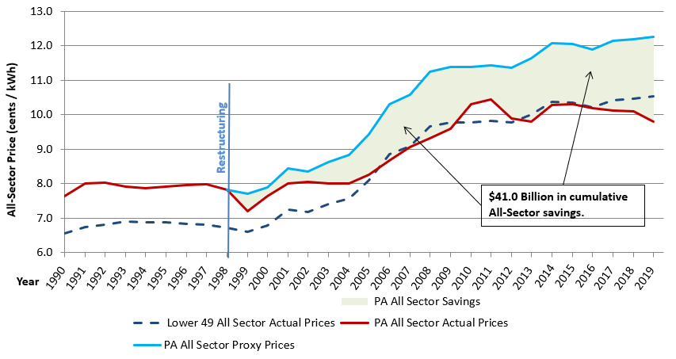
PA All-Sector Savings Estimate

Slide 6
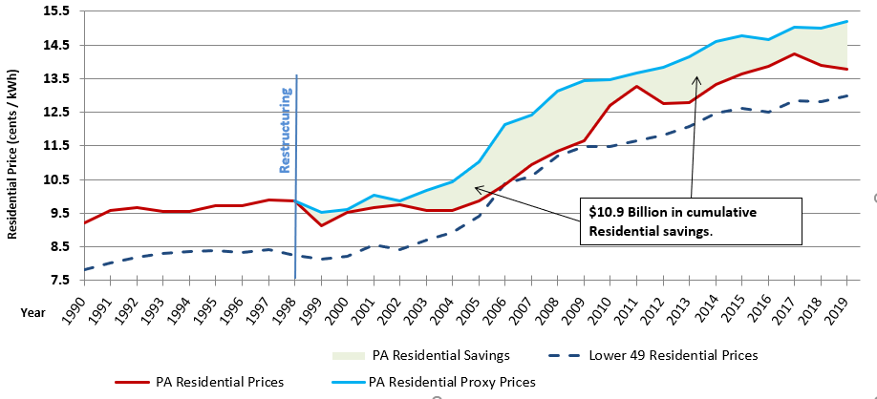
PA Residential Savings Estimate
PA residential Savings Estimate

Slide 7
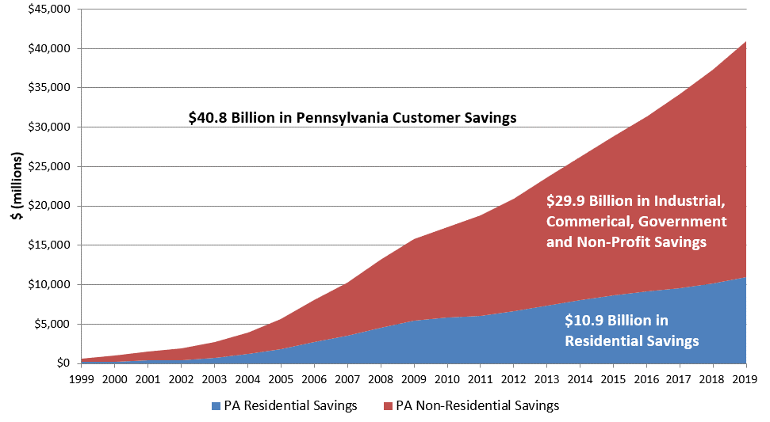
PA Residential and non-residential Cumulative Savings Estimate

