Slide 1
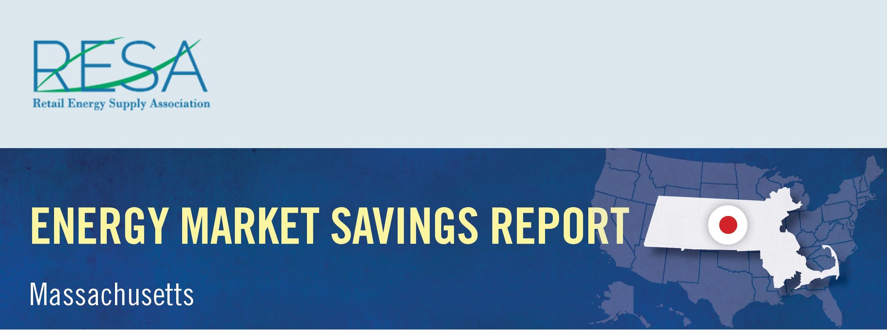
By shopping for the best deal for electricity, Connecticut consumers could have saved nearly $11.5 million in January and benefited from a wide range of value-added products and services by switching to competitive suppliers.
Savings Over
Eversource – CL&P: | $10,931,757
United Illuminating: | $563,736
January Potential Market Savings: | $11,495,493
January Notable Offers:
Monthly shopping/dining certificate
Electric vehicle charger rebate and free weekend EV charging
Charitable donation based on customer usage
Source: Connecticut Rate Board – www.energizect.com

