Slide 1
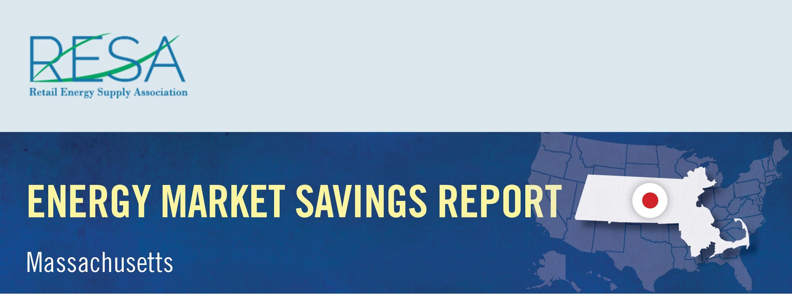
By shopping for the best deal for electricity, Connecticut consumers could have saved more than $8 million in October and benefited from a wide range of value-added products and services by switching to competitive suppliers.
Savings Over
Eversource – CL&P: | $5,183,141
United Illuminating: | $2,952,560
October Potential Market Savings: | $8,135,701
October Notable Offers:
Airline reward miles available
Charitable donation based on customer usage
Source: Connecticut Rate Board – www.energizect.com

