Slide 1
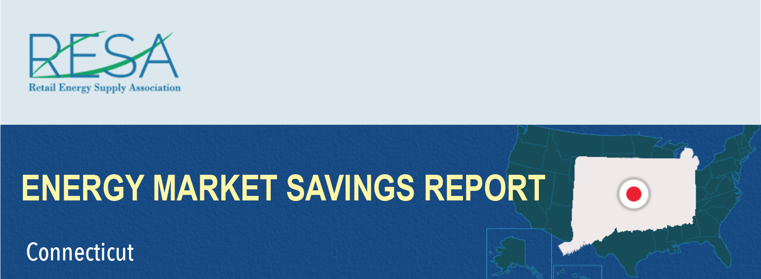
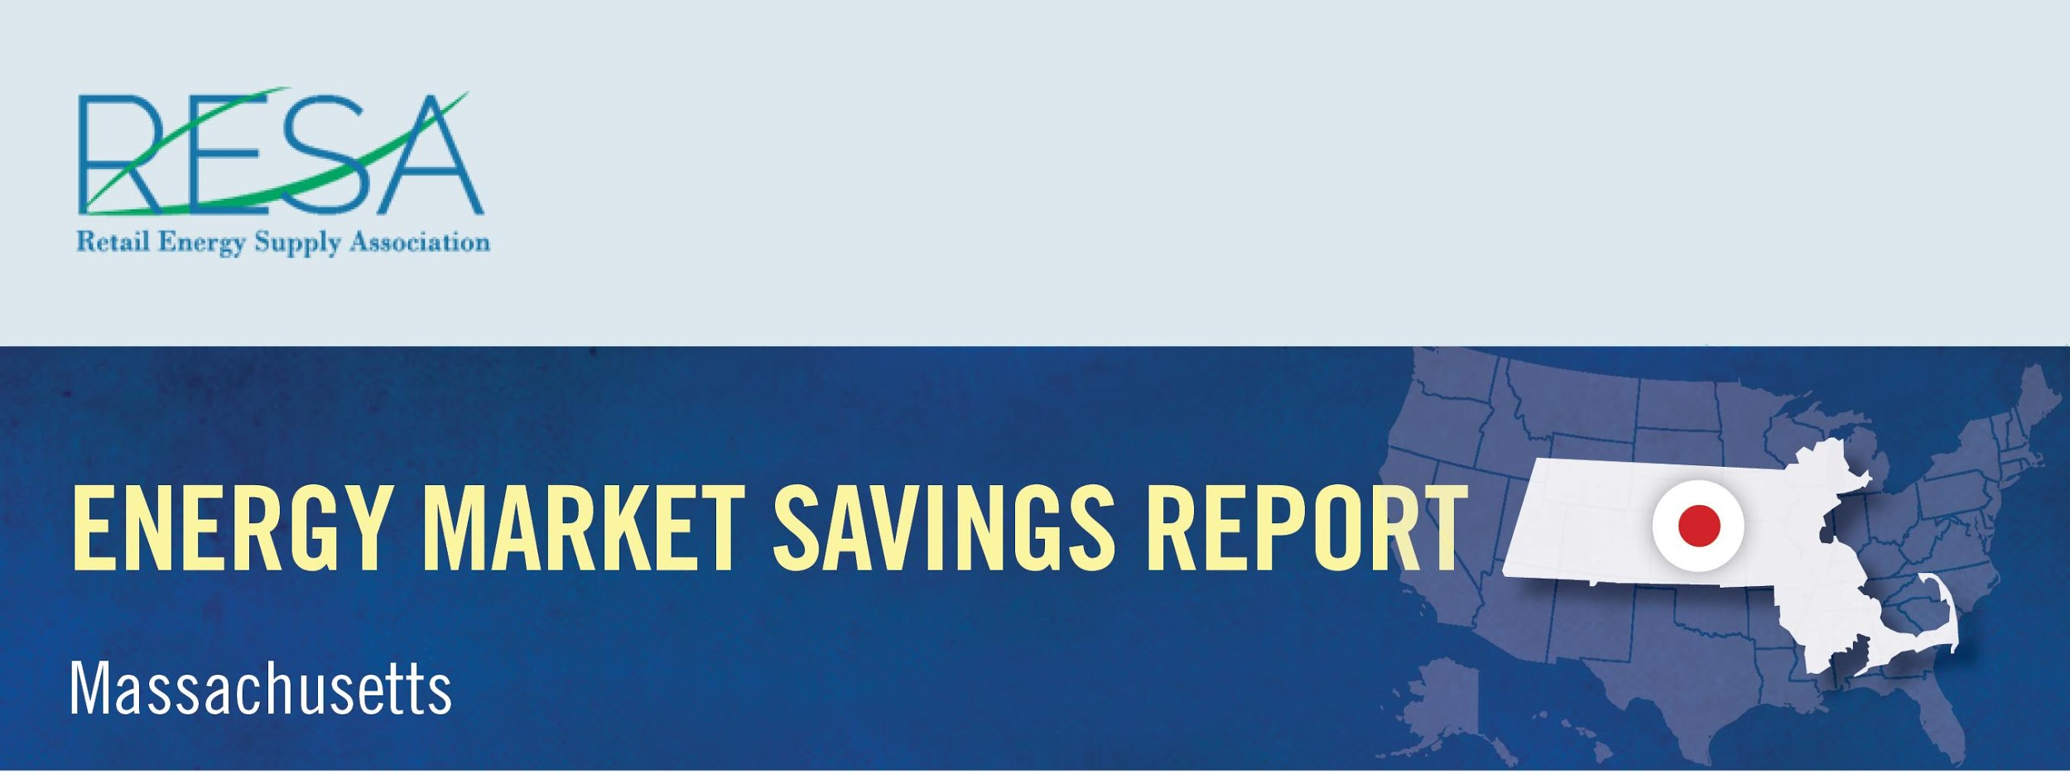
By shopping for the best deal for electricity, Connecticut consumers could have saved more than $13 million in November and benefited from a wide range of value-added products and services by switching to competitive suppliers.
Savings Over
Eversource – CL&P: | $10,213,291
United Illuminating: | $2,855,520
November Potential Market Savings: | $13,068,811
November Notable Offers:
Airline reward miles available
Charitable donation based on customer usage
Source: Connecticut Rate Board – www.energizect.com

