Slide 1
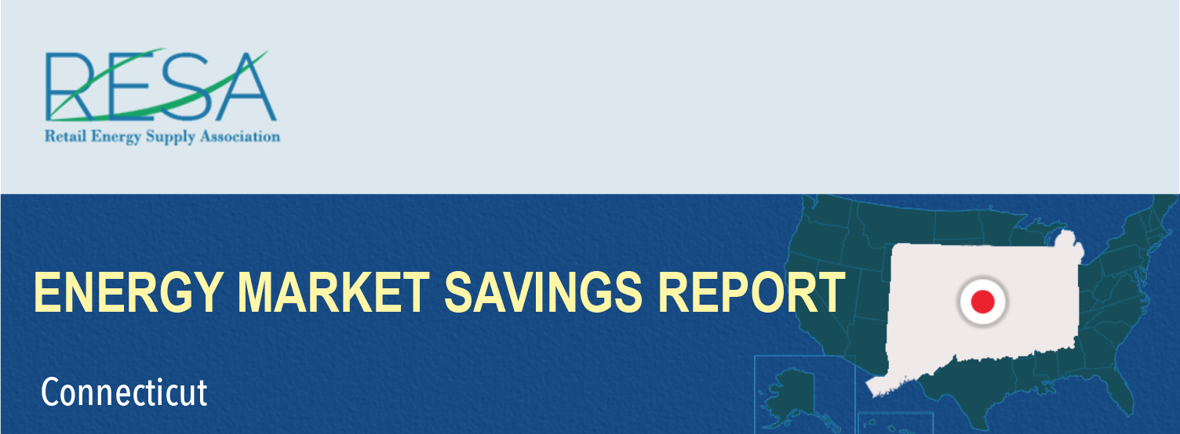
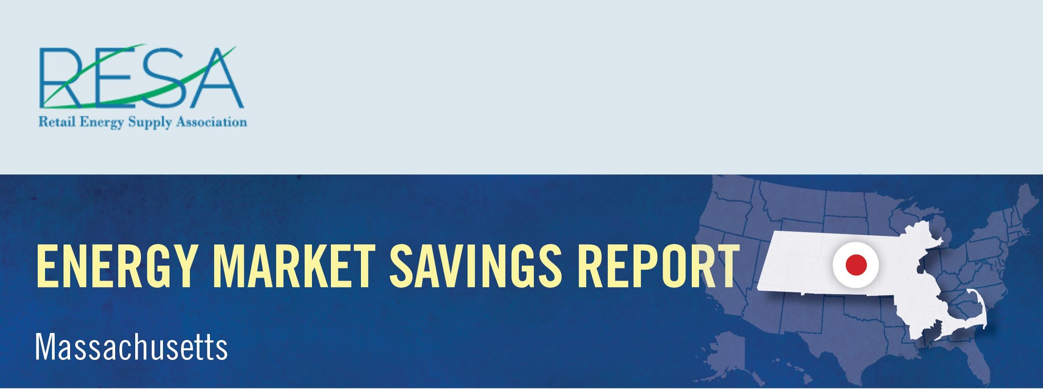
By shopping for the best deal for electricity, Maryland consumers could have saved more than $43.3 million in November and benefited from a wide range of value-added products and services by switching to competitive suppliers.
Savings Over
BGE: | $22,099,850
Delmarva MD: | $5,084,647
Potomac Edison: | $3,577,911
Pepco MD: | $12,611,273
November Potential Market Savings: | $43,373,680
November Notable Offers:
$50 worth of reward dollars per month; 25% rebate on average monthly supply charges after 12-months
Four trees planted in partnership with the Arbor Day foundation over 12-month term
Access to a online marketplace that uses reward dollars to purchase a variety of energy-saving products for your home
Source: MD PSC – www.psc.state.md.us/electricchoice/shop-and-compare/

